Slide 1


PYTHON ASP PROJECT
Presented by NIKKI(1-5) & CECILIA(6-10)

Slide 2
what is the project objective?
To import excel sheets and create graph using different functions and dataframe using python and share the codes that works along the way using github VCS

Slide 3


Packages Involve
NUMPY
MATPLOTLIB
PANDAS
XLRD

Slide 4



Step 1
We first divide our task to do for each person
Step 2
Python Project Timeline
We code out the project & unit testing
The steps and progress on how we did our ASP Project
Step 3
We screenshot the results and do the code explanation
Step 4
Powerpoint slides

Slide 5

How we share & collaborate
We first decide who would be the owner and who would be the collaborater
The owner than create the python folder and share to github
At github we add the collaborater so that we both of us will have the same file and able to push and pull the codes
Everytime when one of us have done the part we are task with one will commit and push in pycharm and the partner will pull the codes down

Slide 6


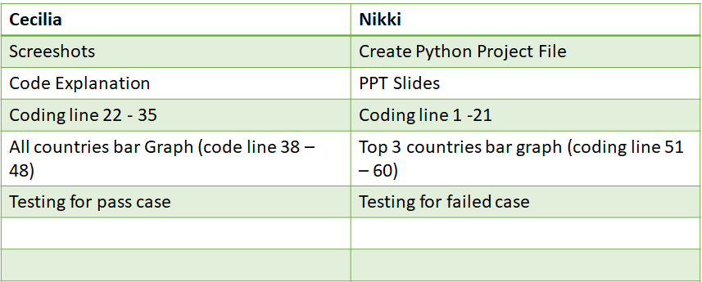

CECILIA
NIKKI
Line 22-35 & Line 38 -48
Slide 1 -5
PPT SLIDES
Slides 6 - 10
Code Explanation
Line 1 – 21 & Line 51 - 60

Slide 7



The project code flow
Step 1
Step 5
We first import python libraries
We Sort the countries values
Step 2
Step 6
Import and read the excel sheet ‘IMVA.xls’
Find the total & mean of the top 3 countries
Step 3
Step 7
Make dataframe for column headers for our selected countries
Make bar chart for All countries & Top 3 countries
Step 4
Step 8
Make the dataframe and get the first 3 and last 3 year range from (2011 – 2020)
Unit testing

Slide 8
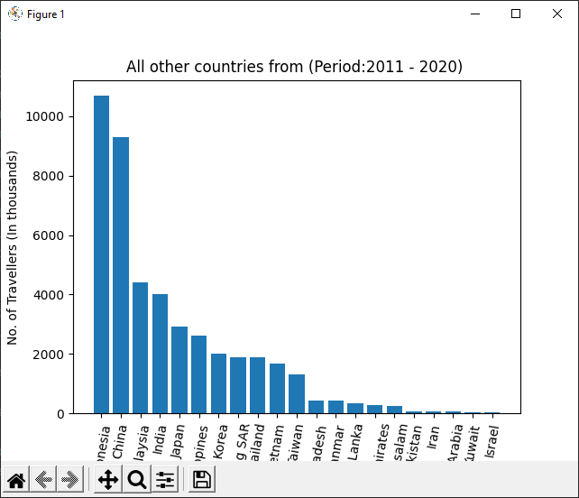
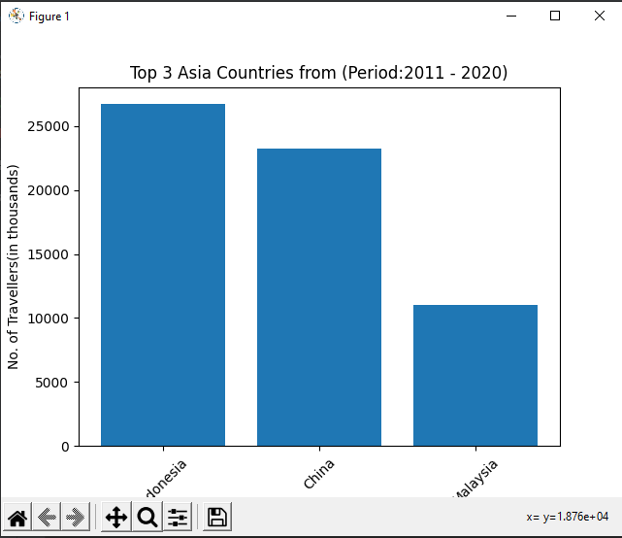
Graph analyse results
Top 3 countries graph
We sort to show top 3 country
We first sort the graph into descending order
We do the label for the X and Y
We put the title
And show the graph
All countries graph
We first sort the graph into descending order
We do the label for the X and Y
We put the title
And show the graph

Slide 9
First we create a class called MyTestCase
Create function to calculate sum & mean
Create new file name group5_ ASP_testcase
Using the new file do the unit testing codes
Unit Test case
How we did our unit test case

Slide 10

Learn more about python and how we can use python to make different charts, import excels into pycharm, learn how to use unit testing to test out the program, learn how to make dataframe.-nikki
What we have benefited from this project
We learn how to use git hub and how we share it with others and to commit , push and pull the codes on different computer without needing to copy the codes to the other person -cecila

